Slide 1
ONE DAY WORKSHOP ON FOIL EMBOSSING
PG DEPARTMENT OF FASHION TECHNOLOGY AND COSTUME DESIGNING & B.VOC APPAREL AND FASHION DESIGN ORGANIZED THE ‘’ONE DAY WORKSHOP ON FOIL EMBOSSING’’ THROUGH ONLINE MODE-MICROSOFT TEAMS PLATFORM FOR THE STUDENTS ON 11TH AUGUST 2021. WE HAVE INVITED THE RESOURCE PERSON MRS.C.ANISHA , ASSISTANT PROFESSOR OF FASHION TECHNOLOGY AND COSTUME DESIGNING, NEHRU COLLEGE OF ARTS AND SCIENCE, COMBATORE.

Slide 2
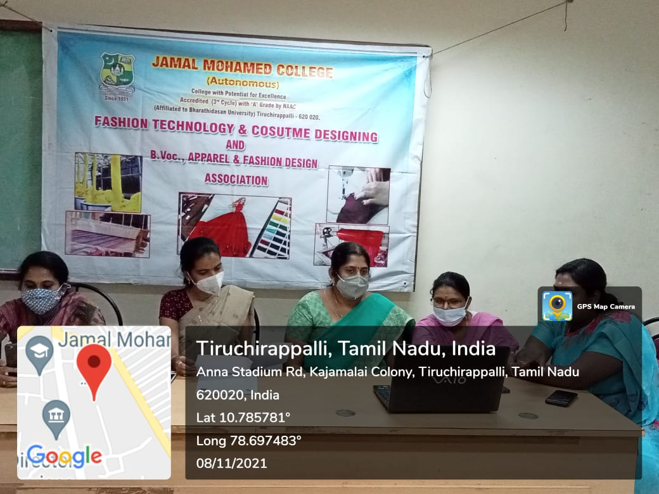

Slide 3
Workshop on Menswear
PG DEPARTMENT OF FASHION TECHNOLOGY AND COSTUME DESIGNING & B.VOC APPAREL AND FASHION DESIGN ORGANIZED THE WORKSHOP ON MENSWEAR. THE WORKSHOP FULLY FOCUSED ON THE MEN’S GARMENT. WE HAVE INVITED THE EXPERT AND SPECIALIST MR. S. JEEVA FOR WORKSHOP.

Slide 5
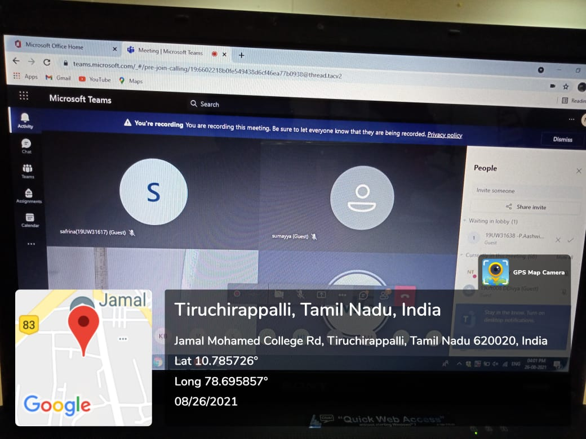

Slide 6
3D DIGITAL TRANSFORMATION OFFASHION INDUSTRY
THE INAUGURATION OF THE FASHION TECHNOLOGY AND COSTUME DESIGNING AND B.VOC APPAREL AND FASHION DESIGN ASSOCIATION WAS HELD ON 17TH SEPTEMBER 2021 THROUGH VIRTUAL MODE – MICROSOFT TEAM. MR. JAGDISH SETHURAMAN, FASHION DESIGNER, PENGUIN APPARELS (P) LTD, MADURAI WAS THE CHIEF GUEST. THE CHIEF GUEST INAUGURATED THE ASSOCIATION FOR THE ACADEMIC YEAR 2021-2022 AND DELIVERED A SPECIAL LECTURE ON “3D DIGITAL TRANSFORMATION OFFASHION INDUSTRY”. HE HIGHLIGHTED THE LATEST DEVELOPMENT IN 3D TEXTILE AND FASHION DESIGNING SOFTWARE AND PATTERN DESIGNING SOFTWARE.

Slide 8
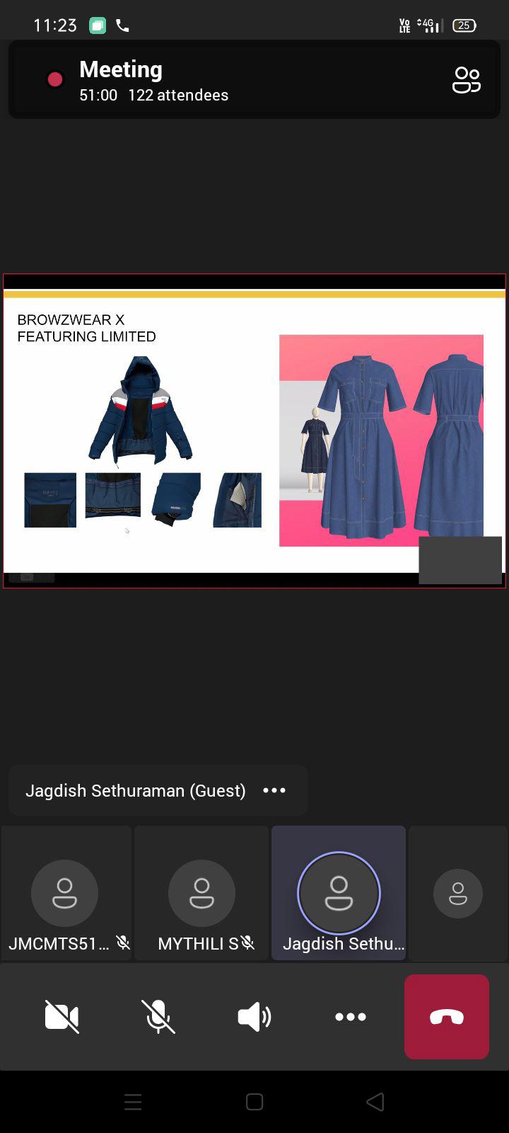

Slide 9
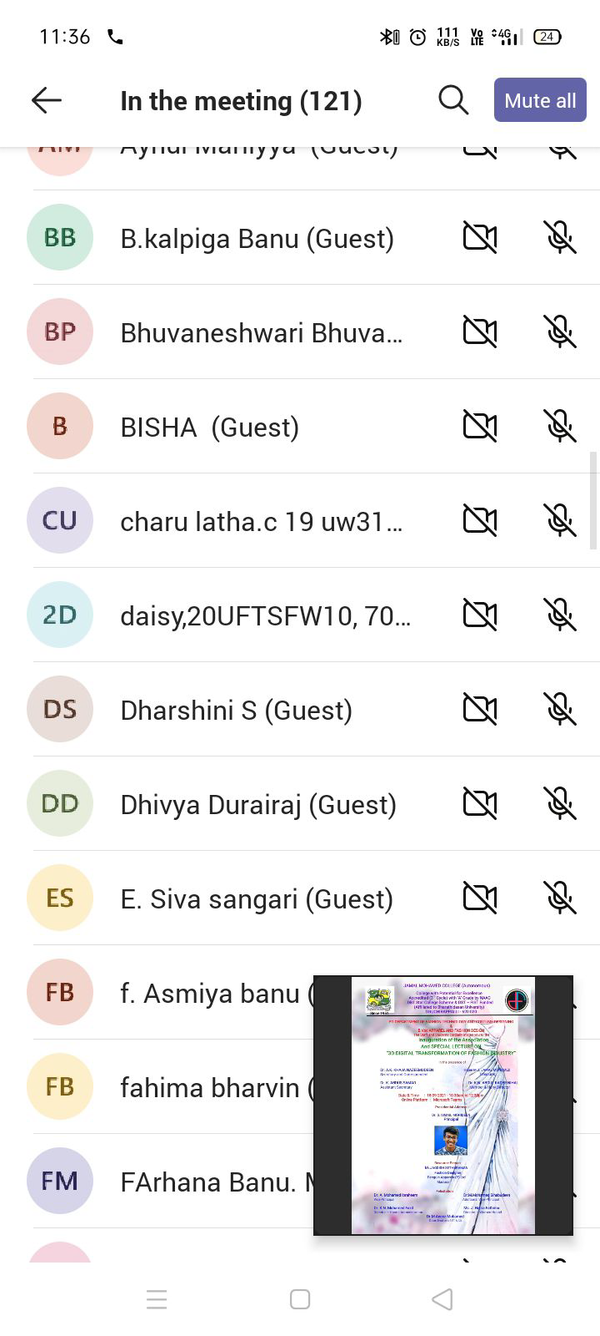

Slide 10
WORLD COTTON DAY CELEBRATION
WITH RESPECT TO WORLD COTTON DAY ON 7TH OCTOBER, WE CELEBRATED COTTON DAY ON 27.10.2021. THE PROGRAM STARTED WITH A SPECIAL LECTURE BY MS.A.YAMINI, FROM JD INSTITUTE OF FASHION TECHNOLOGY BANGALORE. THE TOPIC BASED ON ‘’PASSION FOR COTTON – THE VERSITALITY OF COTTON’’. THE GUEST GAVE A WONDERFUL EXPLANATION ON THE COTTON AND ITS VERSITALITY. THE STUDENTS OF OUR DEPARTMENT EXHIBITED THE VALUES OF COTTON BY USING THE BOARDS AND DISTRIBUTED COTTON MASKS AND COTTON CANDY IN THE COLLEGE. THE STUDENTS CREATED AN ILLUSTRATION TO CREATE AN AWARENESS OF COVID 19 ALONG WITH THE COTTON MATERIALS. DR.MARIO JAGAN, MOTIVATIONAL SPEAKER GAVE AN SPEECH ON THE EFFORTS TAKEN BY THE STUDENTS OF FASHION TECHNOLOGY.

Slide 11
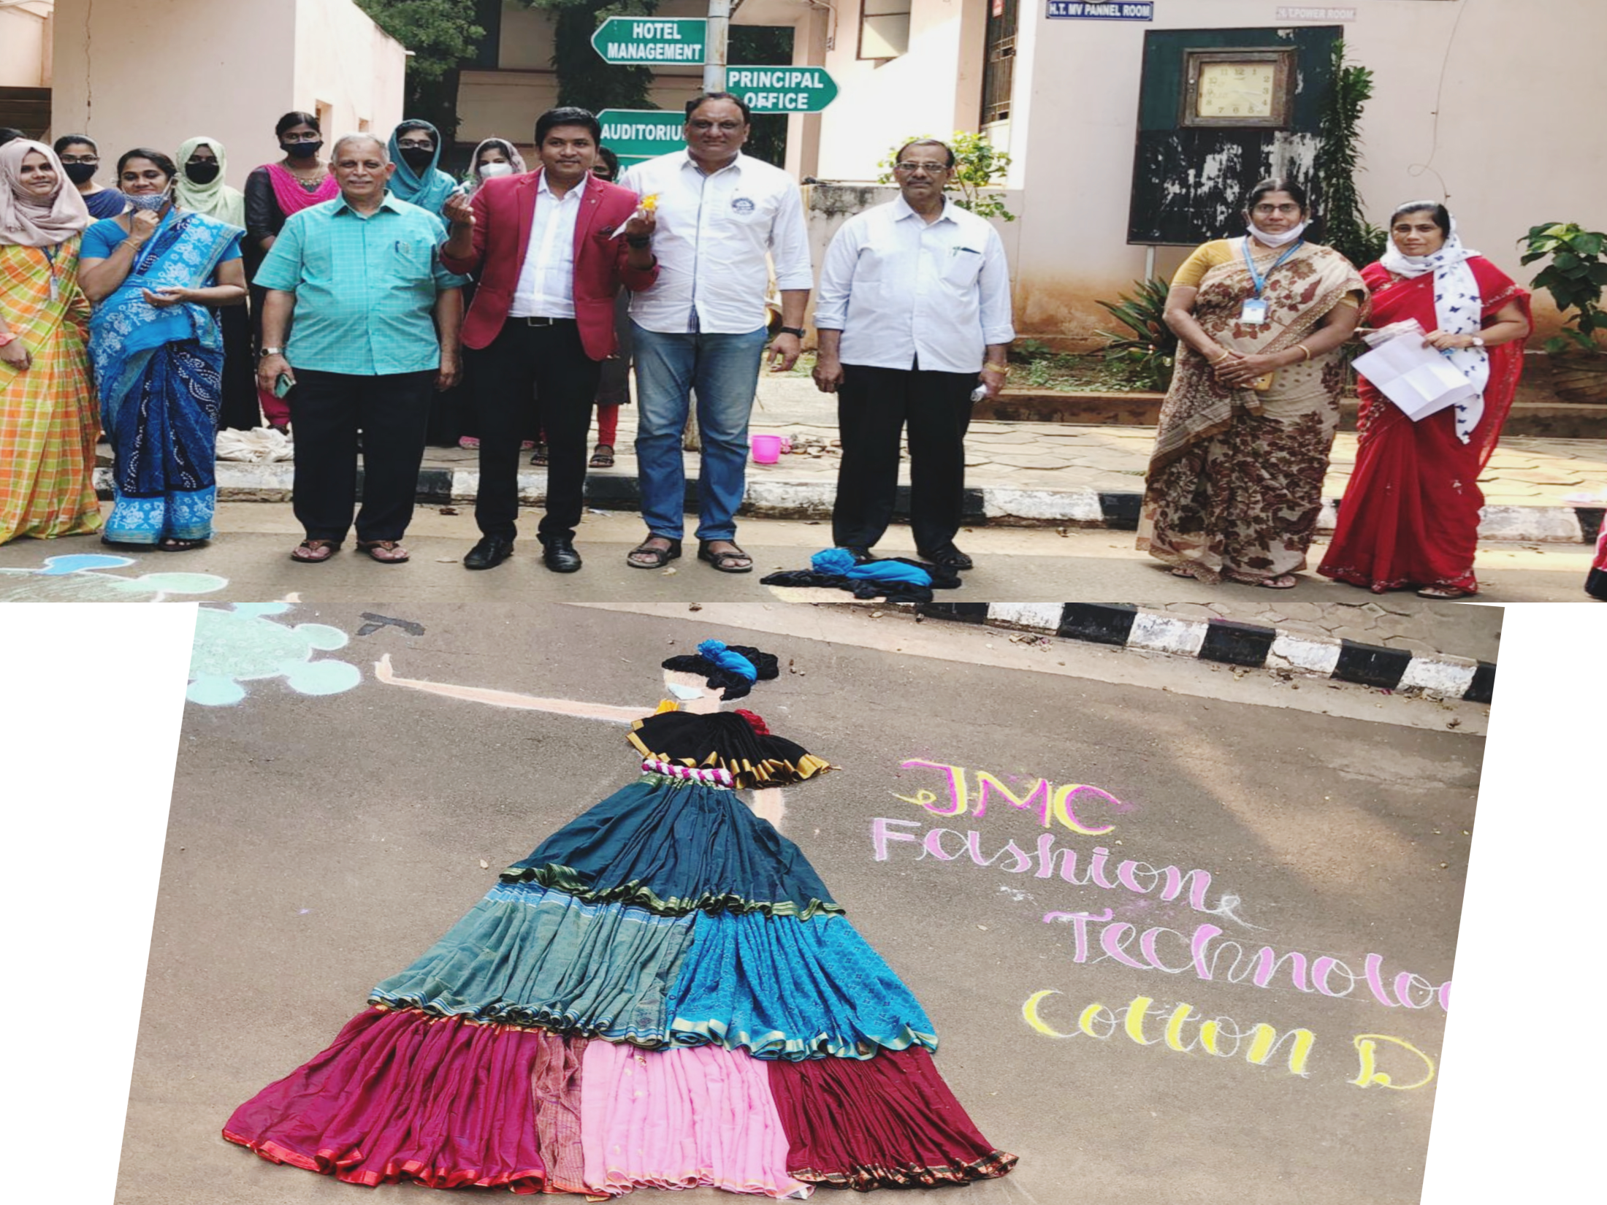

Slide 12
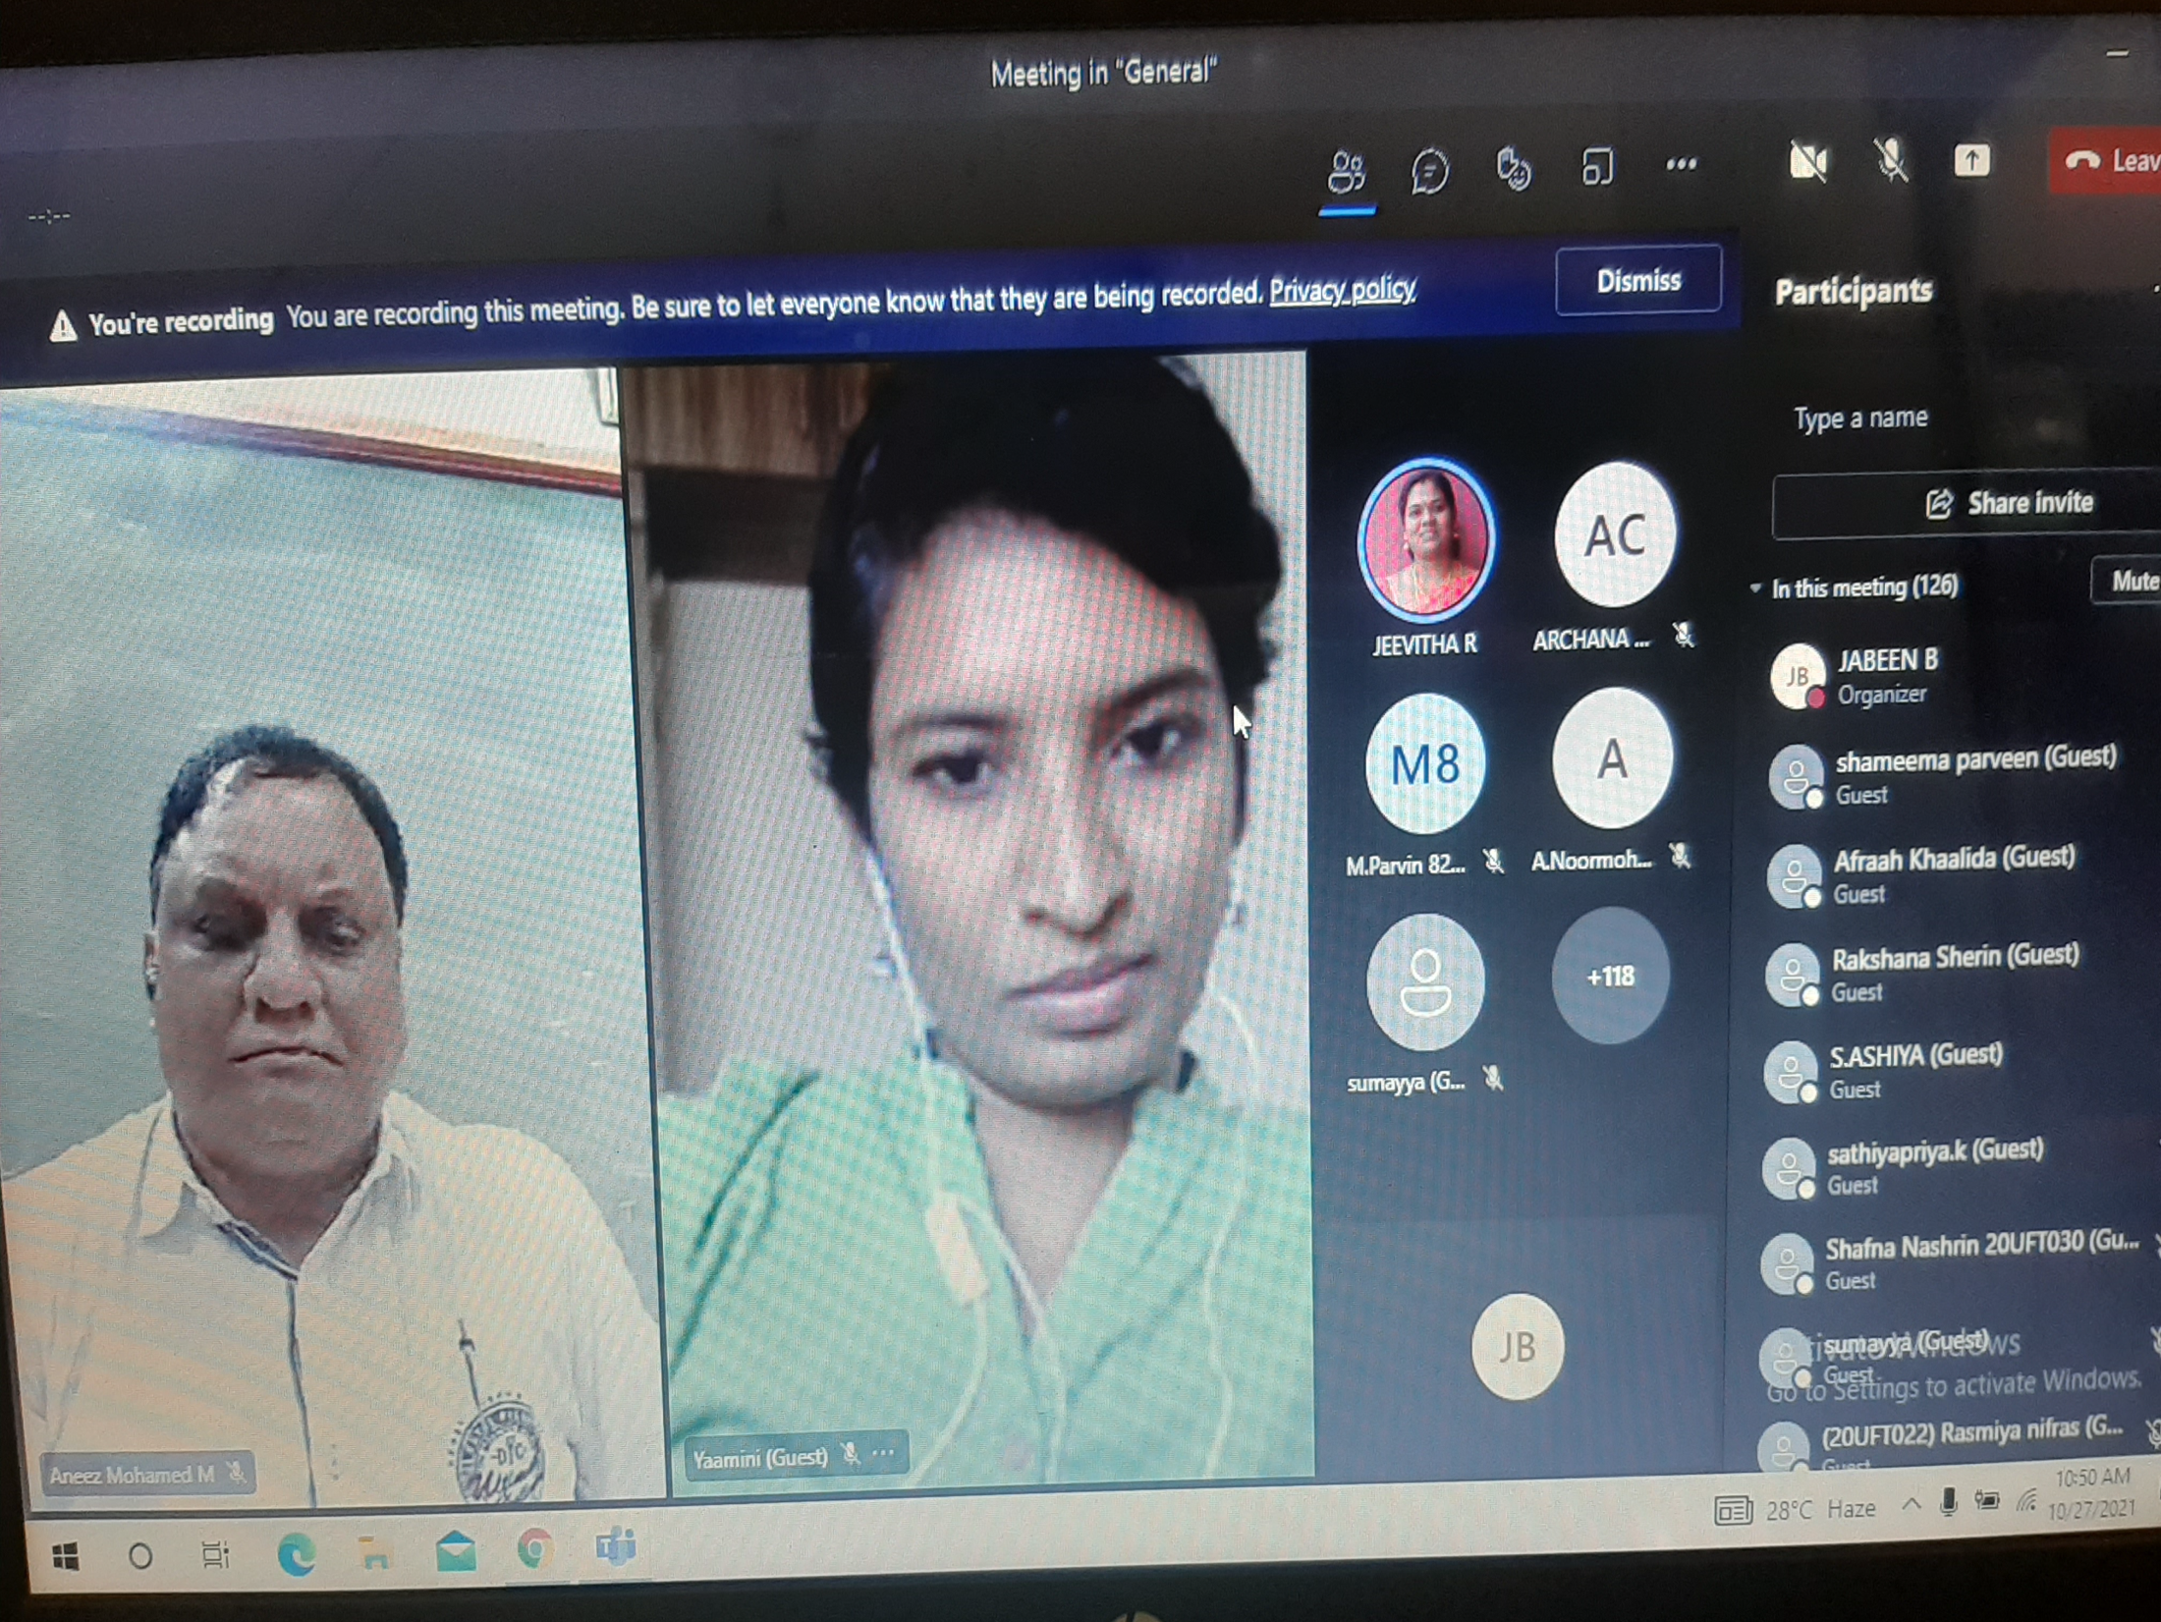

Slide 13
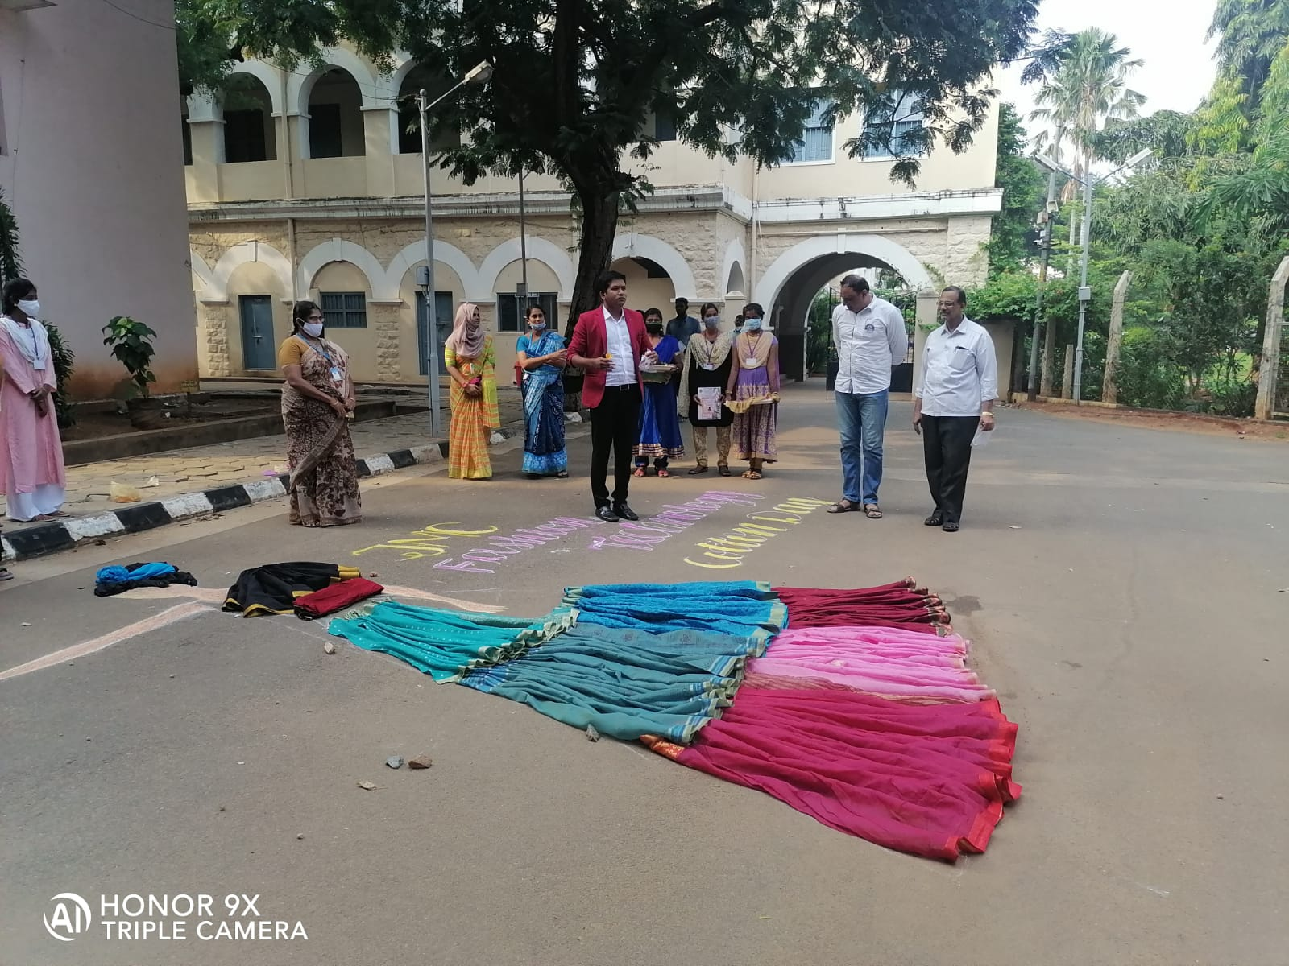

Slide 14
WORKSHOP ON FASHION PHOTOGRAPHY
PG DEPARTMENT OF FASHION TECHNOLOGY AND COSTUME DESIGNING AND B.VOC APPAREL AND FASHION DESIGN ASSOCIATION HAS CONDUCTED THE FASHION PHOTOGRAPHY WORKSHOP ON & 11.03.2022. THE WORKSHOP WAS INAUGURATED IN THE AFTERNOON BY 2.30 P.M BY THE COORDINATOR OF THE DEPARTMENT DR. M. ANEEZ MOHAMED. 30 WERE STUDENTS PARTICIPATED IN THE WORKSHOP. MR.SHANMUGA VELAYUTHAM ASSISTANT PROFESSOR OF B.VOC MEDIA PRODUCTION DEPARTMENT WAS THE RESOURCE PERSON. THIS WORKSHOP WAS FRUITFUL AND CONDUCIVE IN LEARNING FOR THE STUDENTS.

Slide 17
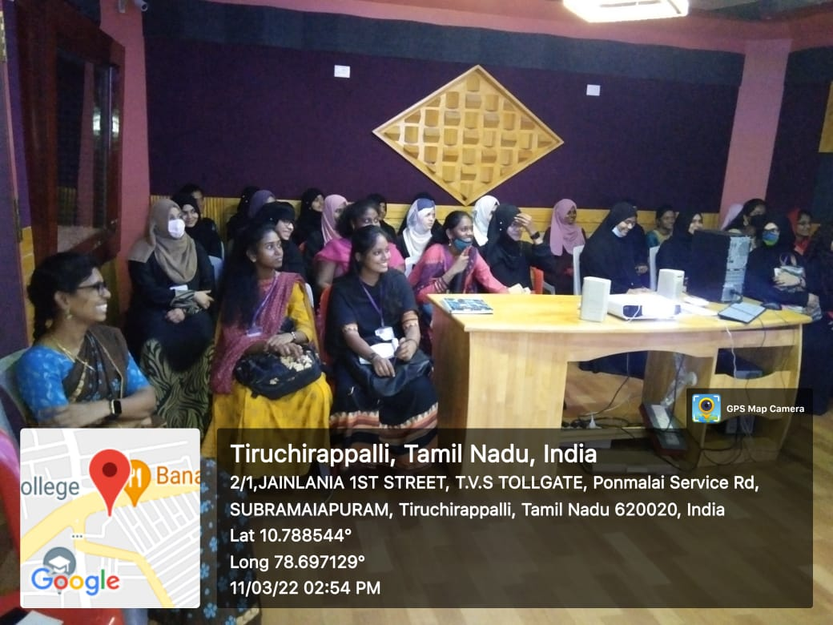

Slide 19
THE INAUGURATION OF SKILL HUB INITIATIVE (SHORT TERM COURSE)
THE INAUGURATION OF THE SKILL HUB INITIATIVE SHORT TERM COURSE- SEWING MACHINE OPERATOR PROGRAMME WAS HELD ON 14TH MARCH 2022.THE INAUGURAL WAS GRACED BY SECRETARY & CORRESPONDENT DR.A.K.KHAJA NAZEEMUDEEN, D.LITT. (USA), PRINCIPAL DR.S. ISMAIL MOHIDEEN, ASSISTANT SECRETARY DR.K. ABDUS SAMAD, DR.M.I. FAZAL MOHAMED (NODAL OFFICER)-B.VOC PROGRAMMES AND DR.M. ANEEZ MOHAMED, CO-ORDINATOR- DEPARTMENT OF FASHION TECHNOLOGY AND COUSTUME DESIGNING. 40 STUDENTS WERE PARCITIPATED IN THIS COURSE.

Slide 22
WORKSHOP ON PAINTING (FEVICRYL)
PG DEPARTMENT OF FASHION TECHNOLOGY AND COSTUME DESIGNING & B.VOC APPAREL AND FASHION DESIGN ORGANIZED THE WORKSHOP ON PAINTING (FEVICRYL). THE WORKSHOP FULLY FOCUSED ON THE JEWELLARY MAKING AND FABRIC PAINTING. WE HAVE INVITED THE EXPERT AND SPECIALIST MS.M.MAYURI FOR THEIR WORKSHOP. HE SHARED HIS EXPERIENCE AND KNOWLEDGE TO THE STUDENTS. TOTALLY 40 STUDENTS HAS PARTICIPATED AND THIS WORKSHOP MAKES USEFULL TO ALL THE STUDENTS.

Slide 24
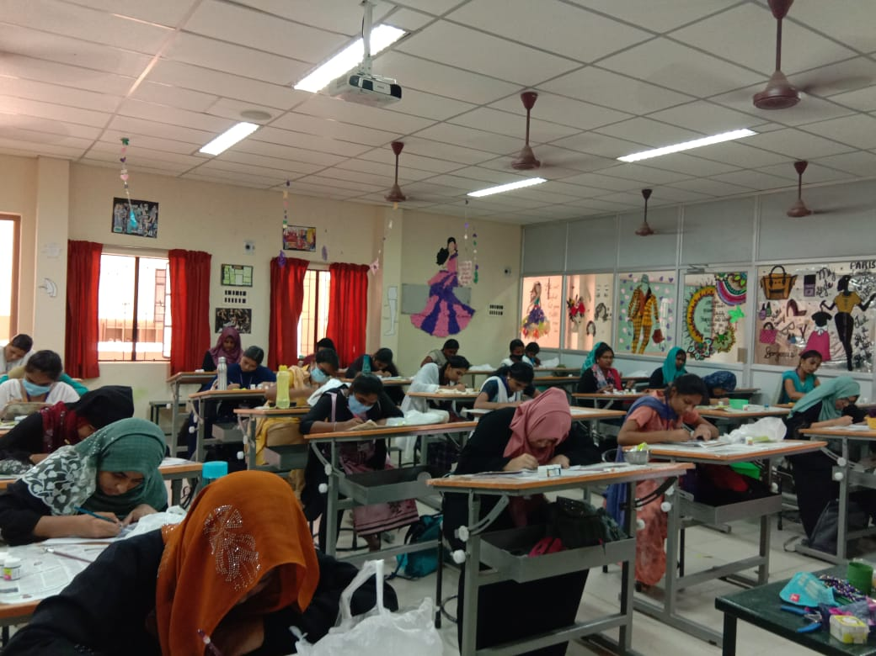

Slide 26
CERTIFICATE COURSE IN AARI EMBROIDERY
PG DEPARTMENT OF FASHION TECHNOLOGY AND COSTUME DESIGNING AND B.VOC APPAREL AND FASHION DESIGN ASSOCIATION HAS CONDUCTED THE CERTIFICATE COURSE IN AARI EMBROIDERY ON 01.04.2022 . THE COURSE WAS INAUGURATED IN THE MORNING BY 11.00 A.M BY THE COORDINATOR OF THE DEPARTMENT DR. M. ANEEZ MOHAMED. 7 STUDENTS WERE PARTICIPATED IN THE AARI COURSE. THIS WORKSHOP WAS FRUITFUL AND CONDUCIVE IN LEARNING FOR THE STUDENTS.

Slide 28
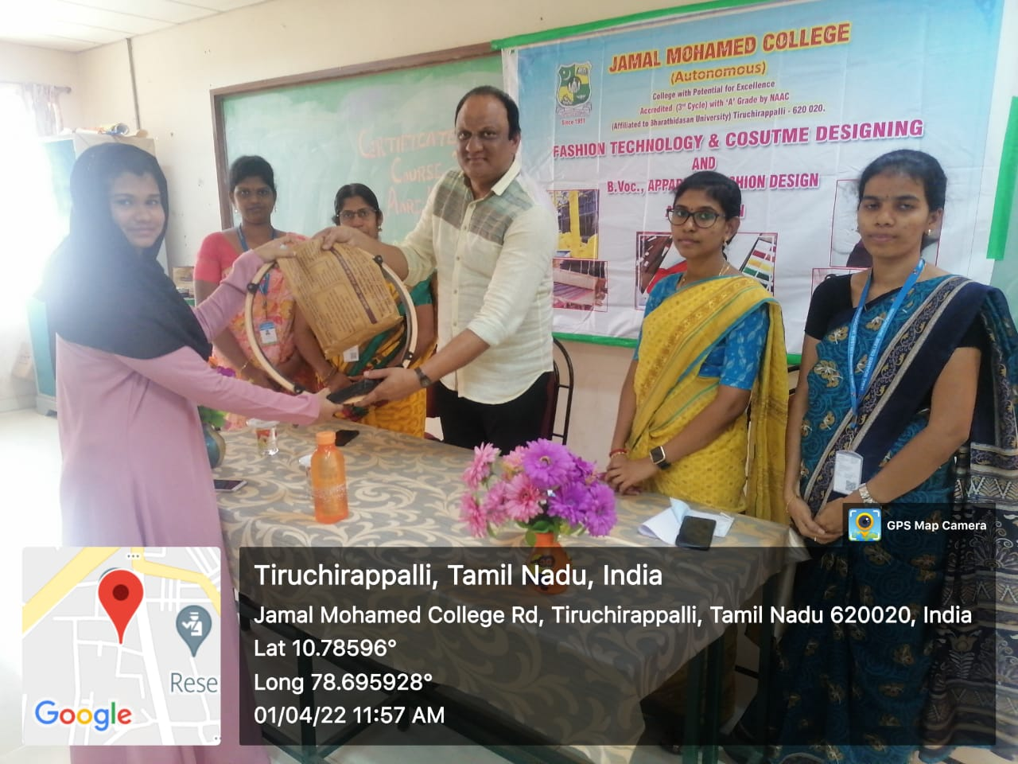

Slide 29
